Slide 1
EECS 482
Lab 01: Threads and Race Conditions

Slide 2
Administrivia
Due dates
Group declarations
01/23
Project 1
01/25
Today: 01/13
Notes:
Those not in groups by this time can be placed into groups by us.

Slide 3
Agenda
Intro
Processes & threads
Race conditions & synchronization
Lab exercises
Project 1

Slide 4
Week in review
Processes, threads, and shared memory
Race conditions
Too Much Milk
Atomic operations
Synchronization
Critical sections
Mutual exclusion (mutex)

Slide 5
Processes, threads, and shared memory

Slide 6
How do threads relate to processes?
Notes:
Why aren't processes enough?

Slide 7
Threads within a process share memory
Process 1
Process 2
Globals and Heap
Globals and Heap
Thread
Stack
Thread
Stack
Thread
Stack
Thread
Stack
Notes:
Processes are protected from each other
Threads in separate processes cannot communicate
Threads in the same process may communicate via shared memory

Slide 8

Why do we want threads?
Notes:
Why aren't processes enough?

Slide 9
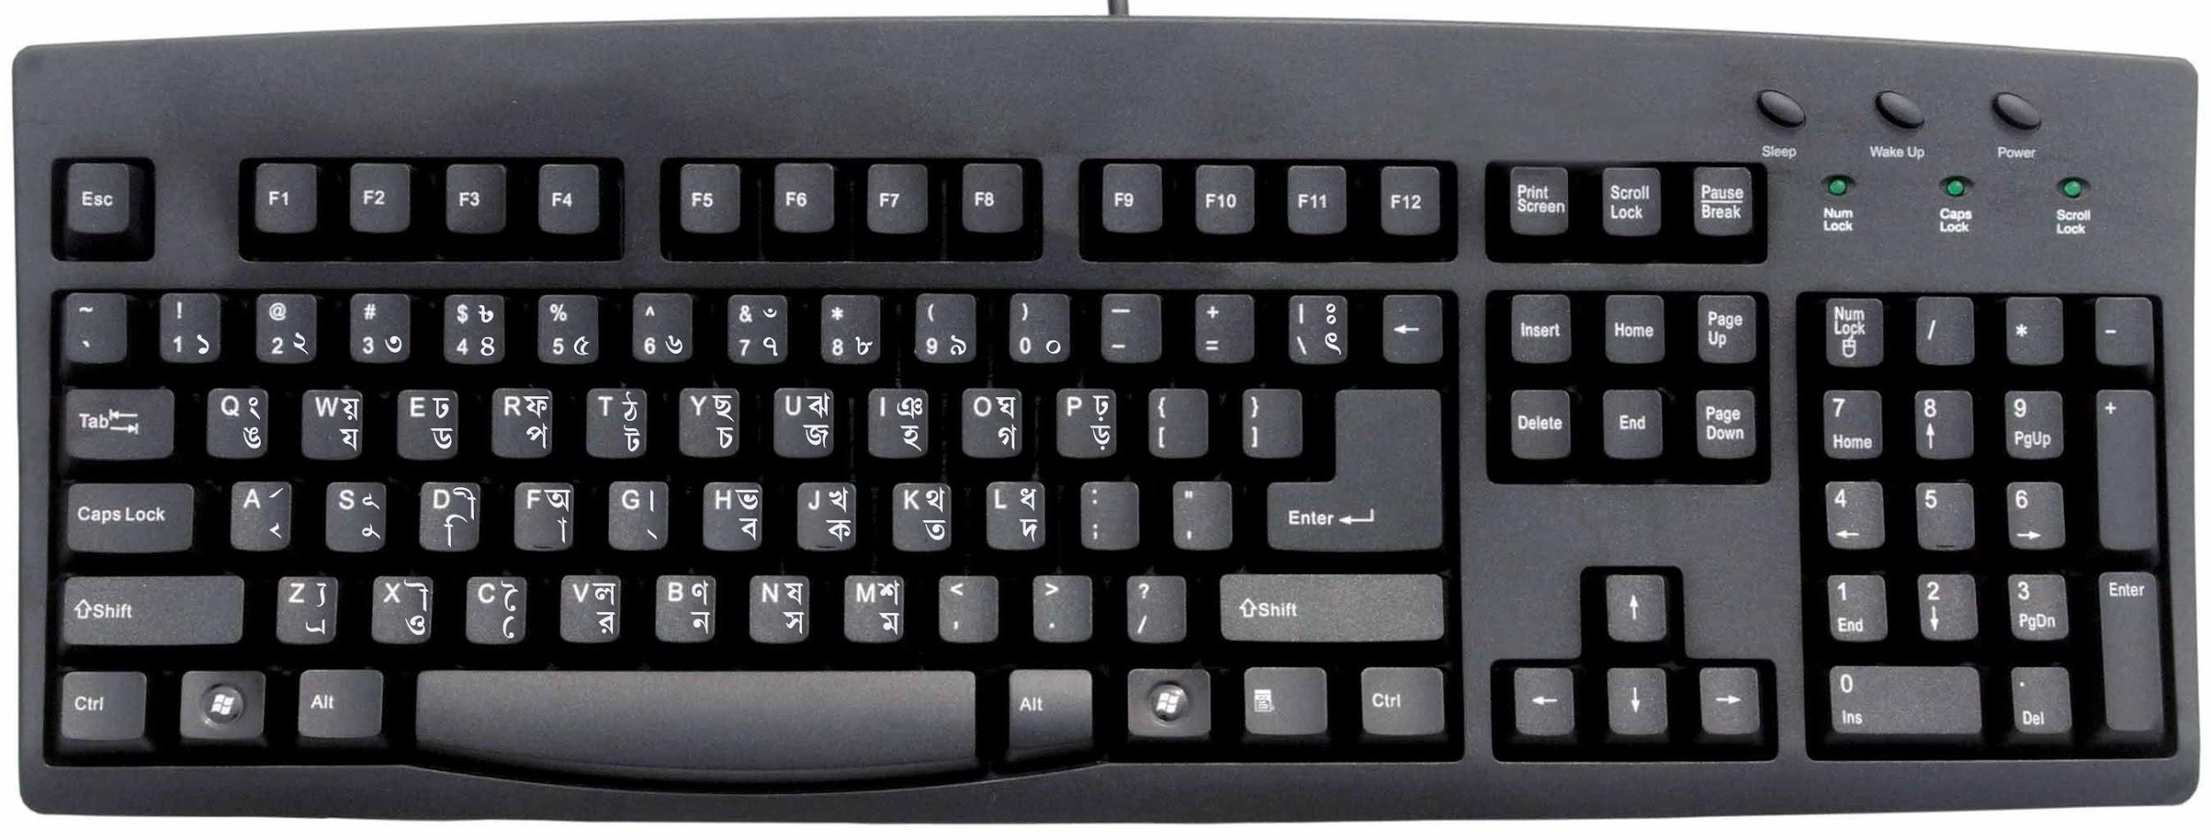

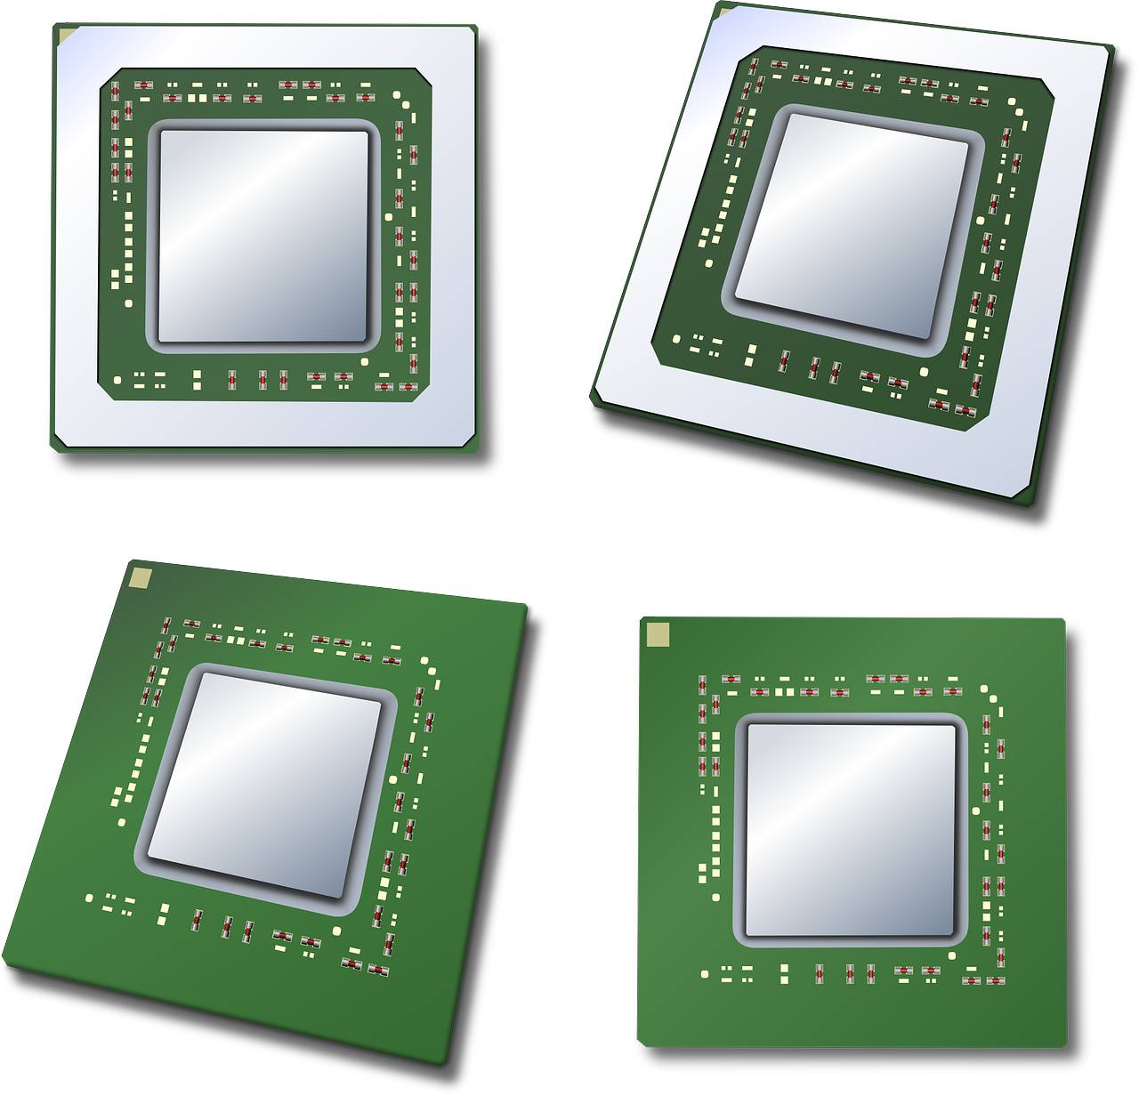


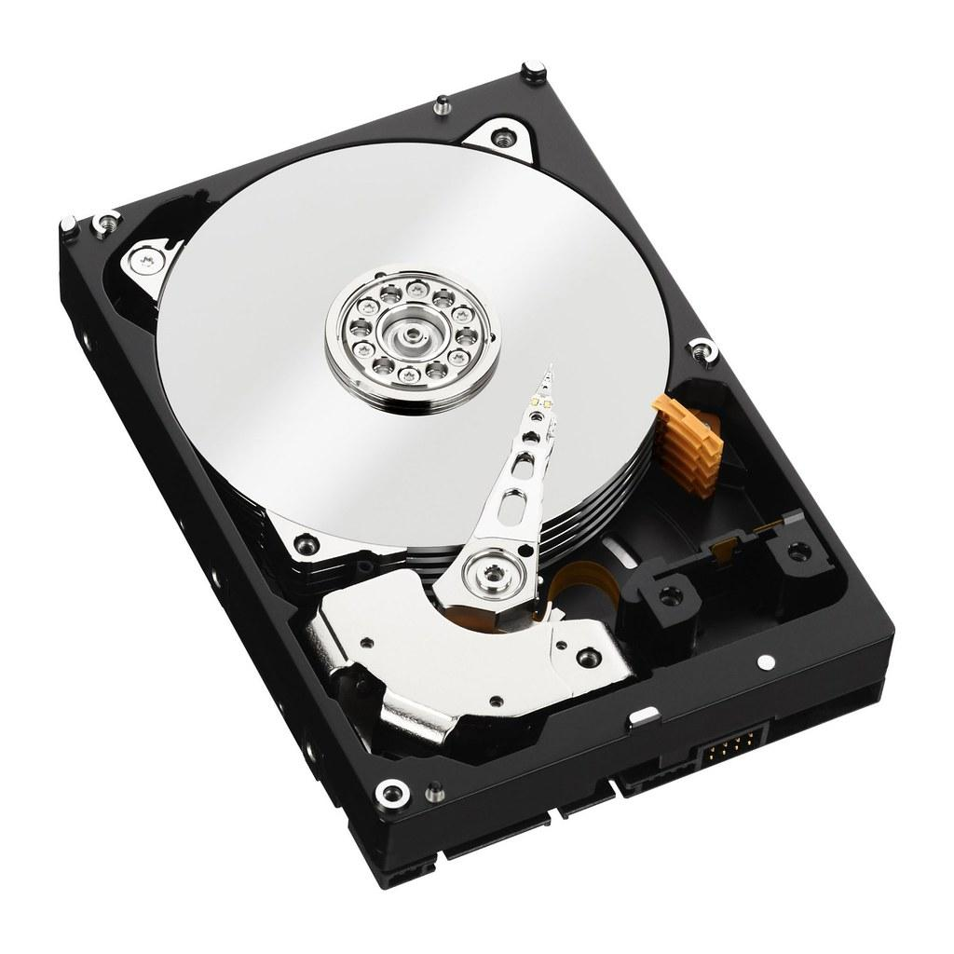

Why do we want threads?
Make use of CPU while waiting on slow I/O
Utilize multiple CPUs to parallelize computation

Slide 10
Atomicity, race conditions, and synchronization

Slide 11
Atomic operations are indivisible.
Thread 1
Thread 2
code();
more_code();
other_code();
codie_code();
hello_world();
*This is a simplification, as functions may not atomic in reality
Notes:
At the end of the day, these programs all decompose into a sequence of atomic operations. The atoms of the program.

Slide 12
Atomic operations are indivisible.
Thread 1
Thread 2
1
1
2
2
3
3
4
*This is a simplification, as functions may not atomic in reality

Slide 13
Atomic operations are indivisible.
CPU
Thread 1
Thread 2
1
1
1
1
2
2
2
3
3
3
4
2
3
4

Slide 14
Don't assume any code you write is atomic!
...unless it is explicitly guaranteed.

Slide 15
Is this atomic? (32 bit system)
int32_t x; ... x++;
Probably not. temp = x + 1; x = temp;

Slide 16
Is this atomic? (32 bit system)
int32_t x; ... x = 1;
Probably. It is likely 1 atomic memory store.

Slide 17
Is this atomic? (32 bit system)
int64_t x; ... x = 1;
Probably not. It is most likely 2 memory stores, one to the lower 32 bits and one for the upper 32 bits.

Slide 18
Operations on shared data form critical sections.
Thread 1
x
(shared data)
Thread 2
x++
more_code();
x++
more_code();
other_code();
more_code();
more_code();
other_code();

Slide 19
Operations on shared data form critical sections.
Thread 1
Thread 2
tmp1 = x + 1
x++
tmp2 = x + 1
x = tmp1
x = tmp2
3
3
4

Slide 20
Non-atomic critical sections lead to race conditions.
CPU
Program 1
Program 2
tmp1 = x + 1
1
1
tmp2 = x + 1
2
2
x = tmp2
3
3
3
4
x = tmp1
3
4

Slide 21
Synchronization prevents race conditions.
We need to manage how multiple threads are allowed to access certain things.
Mutual exclusion: only one thread can do this at a time (mutex)
Ordering: this thread must wait until some condition is true (condition variable; cv)

Slide 22
Mutexes provide mutual exclusion between critical sections
lock(): acquires mutex or waits until released
unlock(): releases ownership of the mutex
m.lock()
m.lock()
tmp1 = x + 1
m
(shared mutex)
tmp2 = x + 1
x = tmp1
x = tmp2
m.unlock()
m.unlock()
3
3
4
Notes:
Now the critical section has become atomic, even though it was originally built up of non-atomic operations.

Slide 23
Condition variables provide communication between threads
wait(mutex m): waits on the cv
m.unlock();
go on a waiting queue
sleep until signal/broadcast is called
m.lock();
signal(): wakes one thread waiting on the cv
broadcast(): wakes all threads waiting on the cv
Notes:
Now the critical section has become atomic, even though it was originally built up of non-atomic operations.

Slide 24
Exercise 1: Threads and races

Slide 25
Exercise 1: Threads and races
const int NUM_THREADS = 2;
const int NUM_ITER = 20;
int counter = 0;
void child() {
for (int i = 0; i < NUM_ITER; i++) {
counter++;
}
}
void main() {
for (int i = 0; i < NUM_THREADS; i++) {
thread t(child); // Simplified syntax
}
}
Notes:
Consider the following multi-threaded program.
It has a shared variable, counter. It spawns 2 threads, each of which calls counter++ 20 times.

Slide 26
Exercise 1: Threads and races
Assume that assignment and addition (but not increment) are atomic.
temp = counter + 1
counter++
counter = temp

Slide 27
Exercise 1A
What is the maximum value that counter can have afterward?
const int NUM_THREADS = 2;
const int NUM_ITER = 20;
int counter = 0;
void child() {
for (int i = 0; i < NUM_ITER; i++) {
counter++;
}
}

Slide 28
Exercise 1A
What is the minimum value that counter can have afterward?
const int NUM_THREADS = 2;
const int NUM_ITER = 20;
int counter = 0;
void child() {
for (int i = 0; i < NUM_ITER; i++) {
counter++;
}
}

Slide 29
Exercise 1B
Compile the program, then use a scripting language to run it 10000 times and summarize the results.
g++ race.cpp -pthread -o race
Notes:
https://github.com/eecs482/lab01_race

Slide 30
Exercise 1C
Change the program to use NUM_THREADS=5 and NUM_ITER=1000000, and run it a few times.
What range of answers do you see? How often does it produce the answer that a naive programmer might expect?
Notes:
Actually don’t see 5*1M a lot. There are a lot more different interleavings since NUM_ITER is high

Slide 31
Exercise 1D
Declare and use a mutex to protect the increment of counter, then re-run the program.

Slide 32
Exercise 2: Mutual exclusion

Slide 33
Assume:
atomic load and store
active[0] = false;
active[1] = false;
turn = 0;
Does this provide mutual exclusion for the critical section?
while(1) {
active[0] = true;
while (turn != 0) {
while (active[1]) {}
turn = 0;
}
<CRITICAL SECTION>
active[0] = false;
}
while(1) {
active[1] = true;
while (turn != 1) {
while (active[0]) {}
turn = 1;
}
<CRITICAL SECTION>
active[1] = false;
}
Notes:
Consider the following pseudo-code, which attempts to provide mutual exclusion for a critical section using only atomic load and store operations.
The idea here is that, when each thread starts, we set its "active" variable to true, and when it's done, it sets it to false. We also have this turn variable to say whether or not a certain thread may continue to the critical section. If it's not this thread's turn, and the other thread is still active, then this thread waits until the other thread is done.
Is this a correct solution? If yes, prove it. If not, provide a counter-example, i.e., an interleaving of threads that allow the two threads to simultaneously access their critical sections.

Slide 34
Project 1

Slide 35
Project 1
Due Jan 25th (Wednesday, < 2 weeks from now)
3 points of your overall grade
Implement a disk IO scheduler

Slide 36
What you are given
Thread library (libthread.o)
thread
mutex
cv
No source code; only the library object file and headers
g++ -o scheduler ${OBJ_FILES} libthread.o -ldl -pthread

Slide 37
Makefile
Capable of compiling the project out-of-the-box, but nothing more
Feel free to modify however you choose, as it (and other starter files) are not submitted
Modify this line to list your *.cpp files:
# List of source files for your disk scheduler
SCHEDULER_SOURCES=file1.cpp file2.cpp

Slide 38
Project 1 Infrastructure: thread.h
thread::thread(thread_startfunc_t func, void *arg)
Spawns a thread
The lifetime of the thread is not tied to the lifetime of the thread object
thread_startfunc_t
typedef void (*thread_startfunc_t) (void *);
Just a type defined in thread.h to be “function which takes one void* as its argument and returns void”
func: function pointer for the thread
Spawned thread executes this code

Slide 39
Project 1 Infrastructure: thread.h
thread::thread(thread_startfunc_t func, void *arg)
Spawns a thread
The lifetime of the thread is not tied to the lifetime of the thread object
void*
A pointer without a type associated with it
Any pointer can be cast to a void*
arg: data to pass to the thread’s function

Slide 40
Project 1 Infrastructure: cpu.h
static void boot(thread_startfunc_t func,
void *arg, unsigned int deterministic)
Spawns the main thread
Must be called before any other infrastructure functions
func: function pointer for main thread
arg: data to pass to main thread
deterministic: 0 for nondeterministic, >0 for deterministic; different values give different results

Slide 41
What’s wrong with this code?
int num = 0;
mutex m;
void func(void *) { printf(“num=%d\n”, num); }
int main() {
m.lock();
num = 42;
m.unlock();
cpu::boot(func, 0, 0);
}
<-- Calling infrastructure function before cpu::boot()

Slide 42
What’s wrong with this code? (Fixed)
int num = 0;
mutex m;
void func(void *) { printf(“num=%d\n”, num); }
int main() {
//m.lock();
num = 42;
//m.unlock();
cpu::boot(func, 0, 0);
}

Slide 43
Detour: CPP-Style Casts
const_cast
Can be used to cast from type const T to T (or T to const T)
Mainly used when there is a function that takes in a non-const argument, even though it does not modify the argument
Modifying a non-const variable which was the result of a cast from a const variable is undefined behavior
void func(char* msg) { cout << msg << endl; }
func("Oops"); //error: const char* is not char*
func(const_cast<char*>("Yay!")); //func should not change msg

Slide 44
CPP-Style Casts (cont.)
dynamic_cast
Used to cast between objects in an inheritance hierarchy
Type check happens at runtime (increased performance overhead)
static_cast
Almost always what you want. Use when you want to
Clarify an implicit conversion
Intentionally truncate data (beware: causes reduction in precision)
Cast type-specified pointers to/from void pointers
e.g. T* to/from void* (necessary for 482 projects)
reinterpret_cast
Can convert between certain unrelated types (numeric to/from pointers)
Does not change the underlying bits
Use with extreme caution - can cause undefined behavior

Slide 45
What’s wrong with this code?
void func(void *a) {
auto my_num = static_cast<int*>(a); // my_num has type int*
cout << *my_num << endl;
}
// Called from cpu::boot()
void main_thread(void *) {
// Spawn 4 threads and give each one a different num
for (int i = 0; i < 4; ++i) {
int num = i * 42;
thread t(func, &num);
}
}
<-- Essentially passing the same address to each thread
Notes:
When casting to/from void *, should use static_cast: https://stackoverflow.com/questions/573294/when-to-use-reinterpret-cast

Slide 46
What’s wrong with this code? (Fixed)
void func(void *a) {
auto my_num = static_cast<int*>(a);
cout << *my_num << endl;
delete my_num;
}
// Called from cpu::boot()
void main_thread(void *) {
// Spawn 4 threads and give each one a different num
for (int i = 0; i < 4; ++i) {
int *num = new int(i * 42);
thread t(func, num);
}
}

Slide 47
What’s wrong with this code? (Fixed pt 2 -- avoid the heap)
void func(void *a) {
auto my_num = reinterpret_cast<uintptr_t>(a);
cout << my_num << endl;
}
// Called from cpu::boot()
void main_thread(void *) {
// Spawn 4 threads and give each one a different num
for (int i = 0; i < 4; ++i) {
uintptr_t num = i * 42;
// note the use of reinterpret_cast
thread t(func, reinterpret_cast<void*>(num));
}
}
Notes:
Explain that intptr_t/uintptr_t should be used when casting numeric types to pointer types

Slide 48
C++ Best Practices
Why are cpp-style casts so long and annoying?
They're meant to be!
They are designed for you to think about the safety of every type conversion - you should only use casts when you have to
Why should I use cpp features if c-style coding works and looks simpler?
Modern features improve readability, safety, and are less bug-prone
For example: std::array, std::optional, std::string, RAII, move semantics, smart pointers, exceptions, cpp-casting, structural binding, STL algorithms, lambda functions, attributes, etc...
Small up front cost to learn leads to significantly better code
Look into clang-format and other formatting tools
Can greatly improve code readability
Notes:
Don’t overuse those features. Always consider whether they’re useful in the first place. Strive for simplicity!

Slide 49
Disk Queue (capacity=3)
Requester 0
785
53
Requester 1
350
914
Requester 2
Current Track
0
827
567
Requester 3
302
230
Requester 4
631
11

Slide 50
Disk Queue (capacity=3)
Requester 0
785
53
785
Requester 1
350
914
Requester 2
Current Track
0
827
567
Requester 3
302
230
Requester 4
631
11

Slide 51
Disk Queue (capacity=3)
Requester 0
785
53
785
350
Requester 1
350
914
Requester 2
Current Track
0
827
567
Requester 3
302
230
Requester 4
631
11

Slide 52
Disk Queue (capacity=3)
Requester 0
785
53
785
350
827
Requester 1
350
914
Requester 2
Current Track
0
827
567
Requester 3
302
230
Requester 4
631
11

Slide 53
Disk Queue (capacity=3)
Requester 0
785
53
785
827
Requester 1
350
914
Requester 2
Current Track
350
827
567
Requester 3
302
230
service requester 1 track 350
Requester 4
631
11

Slide 54
Disk Queue (capacity=3)
Requester 0
785
53
785
302
827
Requester 1
350
914
Requester 2
Current Track
350
827
567
Requester 3
302
230
Requester 4
631
11

Slide 55
Disk Queue (capacity=3)
Requester 0
785
53
785
827
Requester 1
350
914
Requester 2
Current Track
302
827
567
Requester 3
302
230
service requester 3 track 302
Requester 4
631
11

Slide 56
Disk Queue (capacity=3)
Requester 0
785
53
785
631
827
Requester 1
350
914
Requester 2
Current Track
302
827
567
Requester 3
302
230
Requester 4
631
11

Slide 57
Disk Queue (capacity=3)
Requester 0
785
53
785
827
Requester 1
350
914
Requester 2
Current Track
631
827
567
Requester 3
302
230
service requester 4 track 631
Requester 4
631
11

Slide 58
Disk Queue (capacity=3)
Requester 0
785
53
785
914
827
Requester 1
350
914
Requester 2
Current Track
631
827
567
Requester 3
302
230
Requester 4
631
11

Slide 59
Disk Queue (capacity=3)
Requester 0
785
53
914
827
Requester 1
350
914
Requester 2
Current Track
785
827
567
Requester 3
302
230
service requester 0 track 785
Requester 4
631
11

Slide 60
Disk Queue (capacity=3)
Requester 0
785
53
230
914
827
Requester 1
350
914
Requester 2
Current Track
785
827
567
Requester 3
302
230
Requester 4
631
11

Slide 61
Disk Queue (capacity=3)
Requester 0
785
53
230
914
Requester 1
350
914
Requester 2
Current Track
827
827
567
Requester 3
302
230
service requester 2 track 827
Requester 4
631
11

Slide 62
Disk Queue (capacity=3)
Requester 0
785
53
230
914
53
Requester 1
350
914
Requester 2
Current Track
827
827
567
Requester 3
302
230
Requester 4
631
11

Slide 63
Disk Queue (capacity=3)
Requester 0
785
53
230
53
Requester 1
350
914
Requester 2
Current Track
914
827
567
Requester 3
302
230
service requester 1 track 914
Requester 4
631
11

Slide 64
Disk Queue (capacity=3)
Requester 0
785
53
230
11
53
Requester 1
350
914
Requester 2
Current Track
914
827
567
Requester 3
302
230
Requester 4
631
11

Slide 65
Disk Queue (capacity=3)
Requester 0
785
53
11
53
Requester 1
350
914
Requester 2
Current Track
230
827
567
Requester 3
302
230
service requester 3 track 230
Requester 4
631
11

Slide 66
Disk Queue (capacity=3)
Requester 0
785
53
567
11
53
Requester 1
350
914
Requester 2
Current Track
230
827
567
Requester 3
302
230
Requester 4
631
11

Slide 67
Disk Queue (capacity=3)
Requester 0
785
53
567
11
Requester 1
350
914
Requester 2
Current Track
53
827
567
Requester 3
302
230
service requester 0 track 53
Requester 4
631
11

Slide 68
Disk Queue (capacity=3)
Requester 0
785
53
567
Requester 1
350
914
Requester 2
Current Track
11
827
567
Requester 3
302
230
service requester 4 track 11
Requester 4
631
11

Slide 69
Disk Queue (capacity=3)
Requester 0
785
53
Requester 1
350
914
Requester 2
Current Track
567
827
567
Requester 3
302
230
service requester 2 track 567
Requester 4
631
11

Slide 70
Coding Tips for P1
Void Pointers
Function Pointers
C++ Project Structure
Link to Slides

Slide 71
Questions?

